Slide 1
lets try to characterize data that can be fixed to cov=I by integer A

Slide 2
when max number at A is 4
A can be [[2,-3],[2,-4]] but not [[5,3],[2,4]]

Slide 3
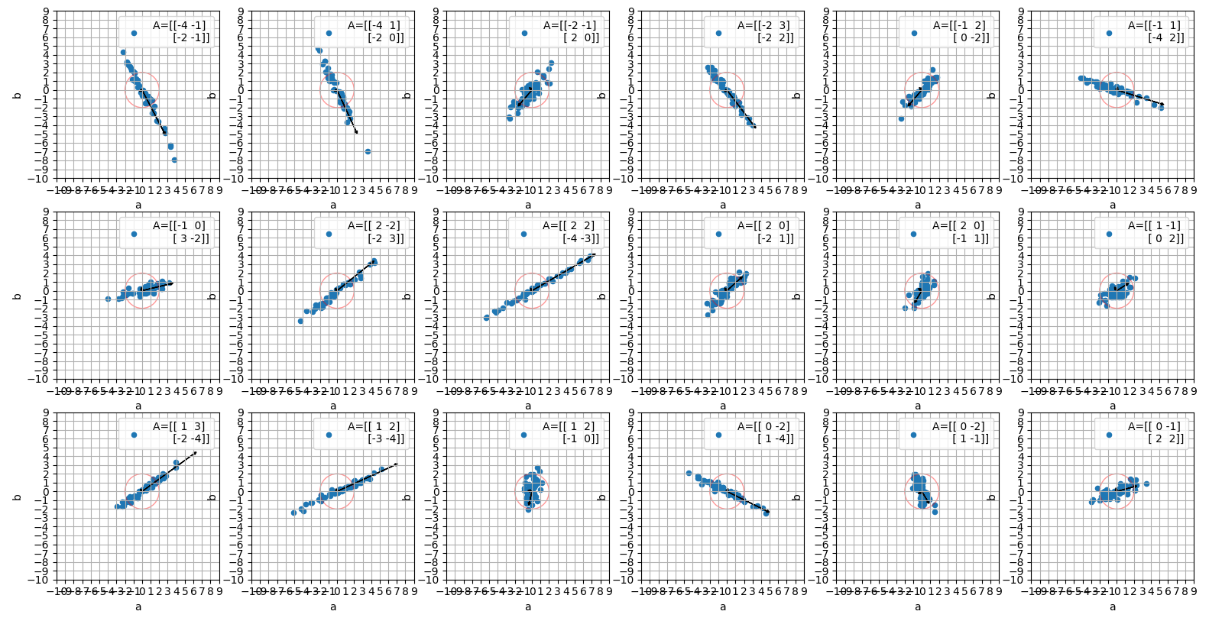
here are some integer A and the data that they fix into cov(D*A)=I

Slide 4
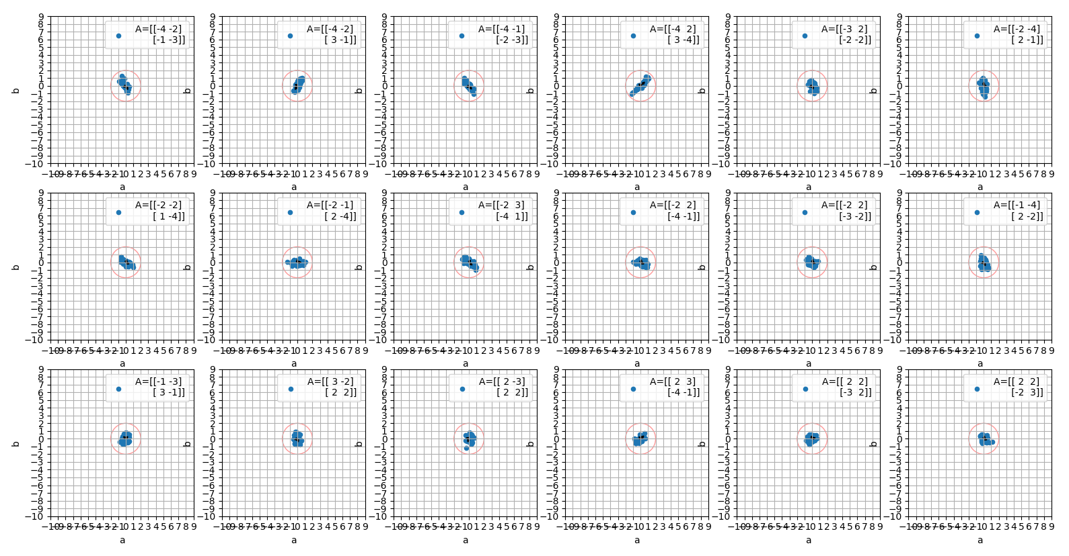
when det(A)=10, the data var should be small

Slide 5
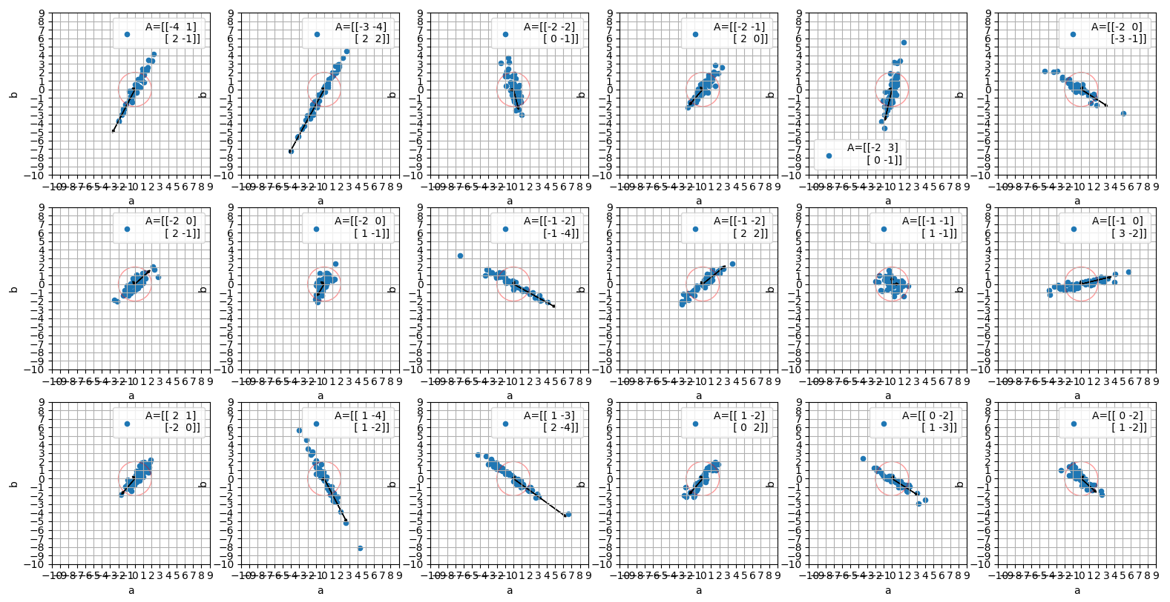
det(A)=2

Slide 6
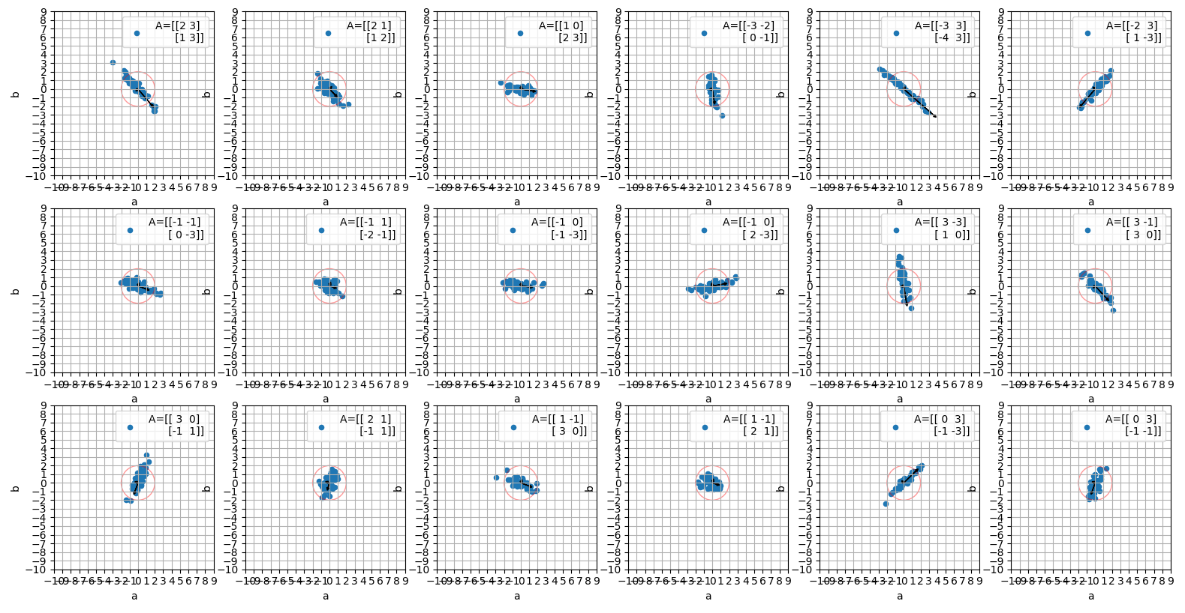
det(A)=3

Slide 7
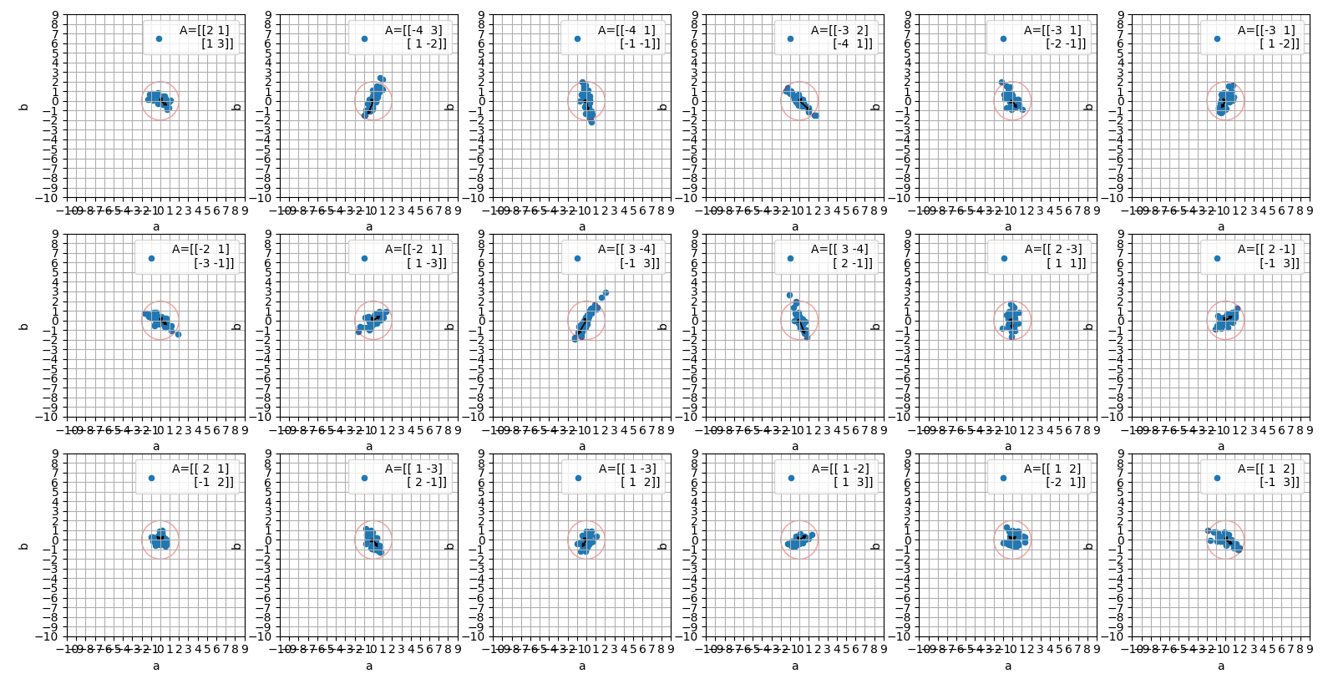
det(A)=5

Slide 8
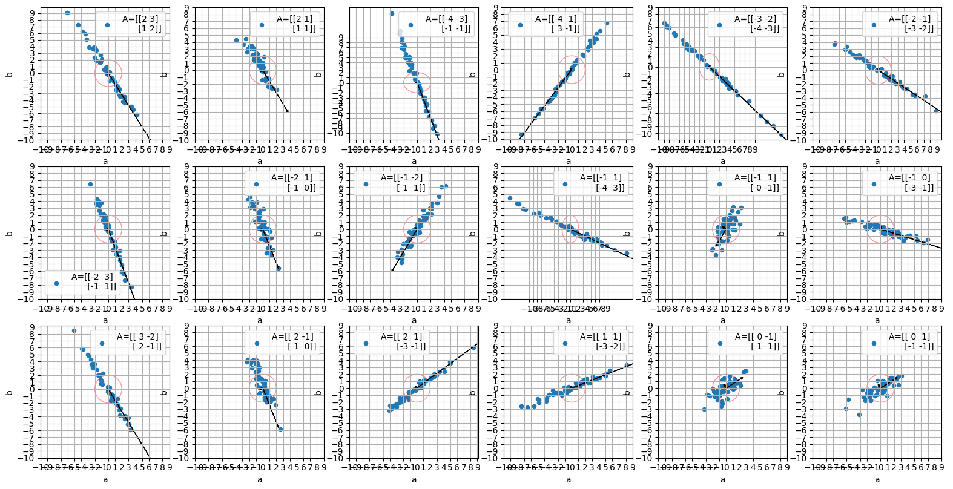
det(A)=1 the most spread one
but if we take max number at A to be higher than 4, we will get more spread also at det(A)>1

Slide 9
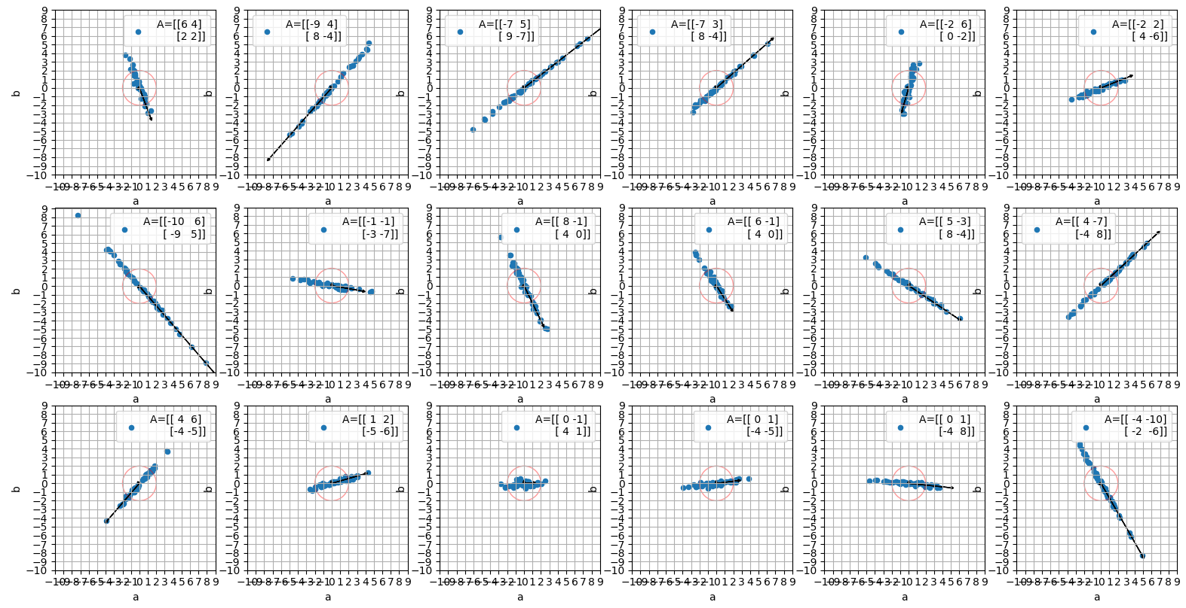
det(A)=4 when max number is 10

Slide 10
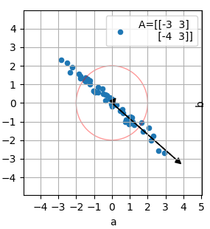
zoom in
we can see 2 arrows here, those are the eigenvectors of the data covariance, multiply in the eigenvalues – the variance at that axis
we have main variance axis and minor
the main one can tell us how correlated the data is and how it spread – will be hard to find A that will fix

Slide 11
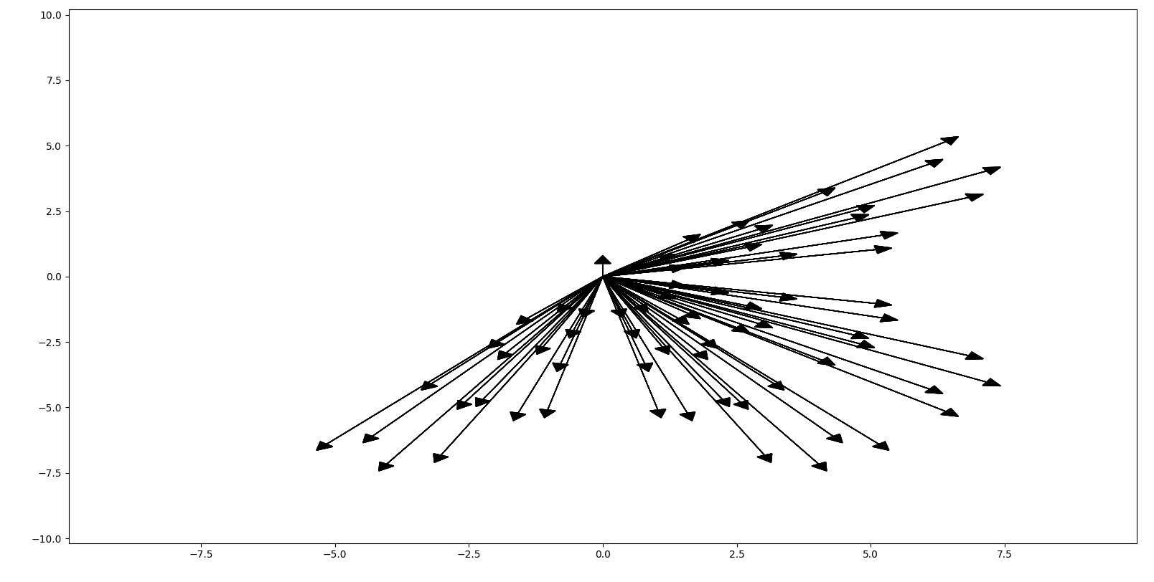
taking main axis of all data corresponding to A with det(A)=2 and max=4

Slide 12
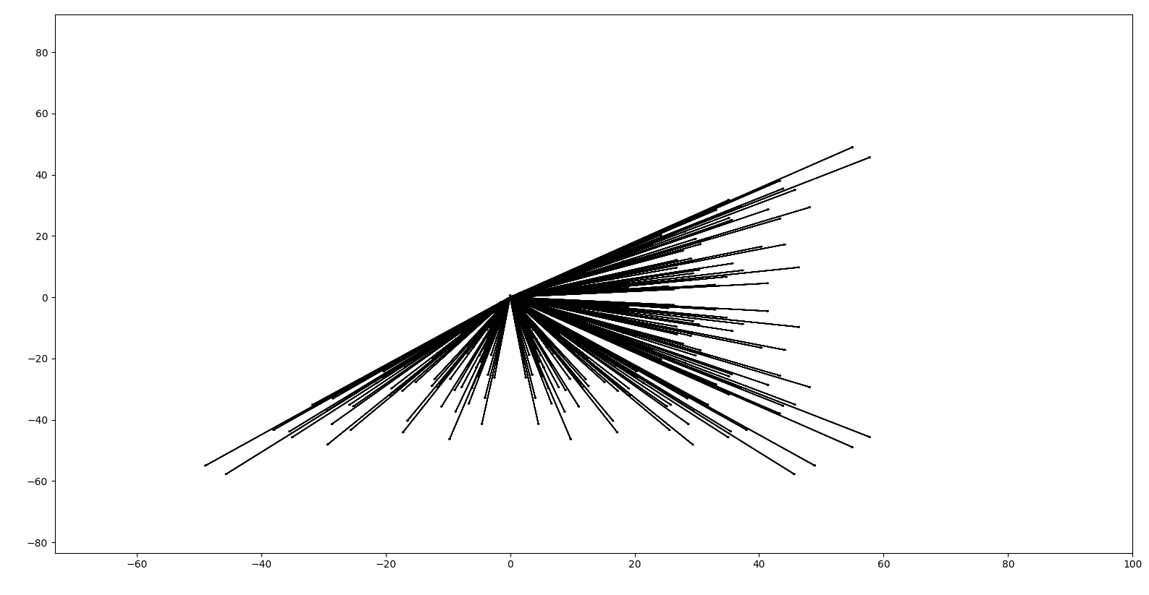
when max=10
look at the max value:
can reach to [60,40], where at max=4 it was at [7,5]

Slide 13
conclusions
as the data is more correlated, the more it’s out of the modulo size…
if we have limit on the correlation, we can also limit the max number at A!
it means that as we limit the correlation, we have fewer options at A
for example, for det)A)=2: when max=4 we have 276 options for A, and for max=8 we have 1044

Slide 14
python code…
import numpy as np import pandas as pd import pylab as plt import itertools,random ''' A composed from vertical vectors, so [[-1,-4],[1,2]] will be vectors of [-1,1] and [-4,2] ''' def data_that_match_A(A): d=np.mat(np.random.normal(0,1, [50,2])) d=d*A.I df = pd.DataFrame(d, columns=['a', 'b']) df['A']=str(A) return df def get_data_angle(A): cov=A.I.T*A.I eig_vals, eig_vecs = np.linalg.eig(cov) right_sort = np.argsort(eig_vals)[::-1] eig_vals = eig_vals[right_sort] eig_vecs = eig_vecs[:, right_sort] angle=np.degrees(np.arctan(eig_vecs[0,0]/eig_vecs[1,0])) return eig_vals, eig_vecs,angle n=8 a=range(-n,n+1) a=[a,a,a,a] As=[np.mat(i).reshape(2,2) for i in list(itertools.product(*a))] # As=[i for i in As if round(np.linalg.det(i))<4 and list(i.A1).count(0)<2 and round(np.linalg.det(i))] As=[i for i in As if round(np.linalg.det(i))==2 and list(i.A1).count(0)<2 and round(np.linalg.det(i))] print(len(As)) random.shuffle(As) df=pd.DataFrame() for A in As[:18]: tmp=data_that_match_A(A) df=pd.concat([df,tmp],axis=0) fig, axes = plt.subplots(3, 6, figsize=(6, 9)) axes=list(pd.DataFrame(axes).values.flatten()) r=10 for name,group in df.groupby('A'): axes[-1].add_patch(plt.Circle((0,0), radius=2, color='r',fill=False,alpha=0.4)) # group.plot(x='a', y='b', kind="scatter",grid=True, xticks=range(-r, r),yticks=range(-r, r),ax=axes.pop(), label="A=" + name.replace("\n", "\n "))# , sharex=True,sharey=True std,eig_vecs,angle=get_data_angle(np.mat(name).reshape((2, 2))) for i in [0,1]: axes[-1].arrow(0, 0, eig_vecs[0, i] * std[i], eig_vecs[1, i] * std[i], head_width=0.3, head_length=0.3, length_includes_head=False, fc='k', ec='k') group.plot(x='a', y='b', kind="scatter",grid=True, xticks=range(-r, r),yticks=range(-r, r),ax=axes.pop(), label="A=" + str(name).replace("\n", "\n "))# , sharex=True,sharey=True # plt.tight_layout(pad=0, w_pad=-1, h_pad=-1) plt.figure() for A in As: std,eig_vecs,angle=get_data_angle(A) for i in [0]: plt.arrow(0, 0, eig_vecs[0, i] * std[i], eig_vecs[1, i] * std[i], head_width=0.3, head_length=0.3, length_includes_head=False, fc='k', ec='k') plt.show()

